Slide 1


Slide 1
HTML
Train

Slide 2
Slide 2
What is HTML?
HTML, otherwise known as Hyper Text Markup Language, is the language used to create Web pages
Using HTML, you can create a Web page with text, graphics, sound, and video
The essence of HTML programming is tags.
A tag is a keyword enclosed by angle brackets
( Example: <I> )
There are opening and closing tags for many but not all tags
The affected text is between the two tags
The opening and closing tags use the same command except the closing tag contains and additional forward slash /.
Eg: <B>Content</B>
Train
2

Slide 3
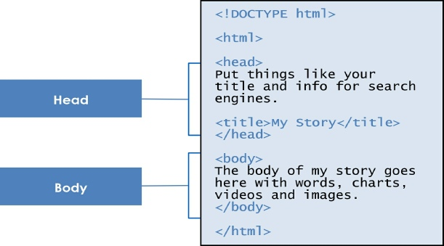
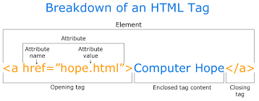
Slide 3
HTML Document – Structure
e
Train
3

Slide 4
Slide 4
Nested, Title and Text Formatting
Nested Tags
Title Tag
Text Formatting
Whenever you have HTML tags within other HTML tags, you must close the nearest tag first
Example:
<H1> <I> The Nation </I> </H1>
Choose the title of your Web page carefully; The title of a Web page determines its ranking in certain search engines
The title will also appear on Favorite lists, History lists, and Bookmark lists to identify your page
<B> Bold Face </B>
<I> Italics </I>
<U> Underline </U>
<P> New Paragraph </P>
<BR> Next Line
Train
4

Slide 5
Slide 5
Hn vs Div vs P
We are all Block Tags
Hn
Div
P
Web pages are typically organized into sections with headings; To create a heading use the expression
<Hn>….</Hn> where n is a number between 1 and 6
The <div> tag defines a division or a section in an HTML document.
The <div> element is often used as a container for other HTML elements to style them with CSS
The <p> tag defines a paragraph.
Browsers automatically add some space (margin) before and after each <p> element.
Train
5

Slide 6
Slide 12
Span
The <span> tag is used to group inline-elements in a document.
<p>My mother has <span style="color:blue">blue</span> eyes.</p>
Pre
The <pre> tag defines preformatted text.
Text in a <pre> element is displayed in a fixed-width font (usually Courier), and it preserves both spaces and line breaks
<pre> Text in a pre element is displayed in a fixed-width font, and it preserves both spaces and line breaks </pre>
Train
6

Slide 7
Slide 12
Comment Statements
Comment statements are notes in the HTML code that explain the important features of the code
The comments do not appear on the Web page itself but are a useful reference to the author of the page and other programmers
To create a comment statement use the <!-- …. --> tags
Train
7

Slide 8
Slide 12
Tables
Tables can be used to display rows and columns of data, create multi-column text, captions for images, and sidebars
The <TABLE> tag is used to create a table; the <TR> tag defines the beginning of a row while the
<TD> tag defines the beginning of a cell
<table> <tr> <th>Month</th> <th>Savings</th> </tr> <tr> <td>January</td> <td>$100</td> </tr> </table>
Train
8

Slide 9
Slide 12
Container vs Non-Container
Container
Non -Container
Container tags are used to enclose texts, images etc. Like <body> , <div> etc are container tags as we put some content inside them.
<title>
<hn>
<p>
<pre>
<div>
<span>
<table><tr><td><th>, etc
Non Container tags can be used inside the container tags. Like you can insert a line-break or an image anywhere in your page but it should be inside some container tag
Img
Br
Hr
Input
meta
Train
9

Slide 10
Slide 12
Img Tag
Type <IMG SRC = “image.ext”>, where image.ext indicates the location of the image file
The WIDTH=n and HEIGHT=n attributes can be used to adjust the size of an image
The attribute BORDER=n can be used to add a border n pixels thick around the image
Some browsers don’t support images. In this case, the ALT attribute can be used to create text that appears instead of the image.
Example:
<IMG SRC=“satellite.jpg” ALT = “Picture of satellite”>
Train
10

Slide 11
Slide 12
Links – Anchor Tag
A link lets you move from one page to another, play movies and sound, send email, download files, and more….
A link has three parts: a destination, a label, and a target
To create a link type
<A HREF=“page.html”> label </A>
In the above link, “page.html” is the destination. The destination specifies the address of the Web page or file the user will access when he/she clicks on the link.
The label is the text that will appear underlined or highlighted on the page
Eg:<A HREF=“www.i-train.co”>i-Train</A>
Train
11

Slide 12
Slide 12
Ordered Lists
Ordered lists are a list of numbered items.
To create an ordered list, type:
<OL>
<LI> This is step one.
<LI> This is step two.
<LI> This is step three.
</OL>
The TYPE=x attribute allows you to change the the kind of symbol that appears in the list.
A is for capital letters
a is for lowercase letters
I is for capital roman numerals
i is for lowercase roman numerals
Train
12

Slide 13
Slide 12
Unordered Lists
An unordered list is a list of bulleted items
To create an unordered list, type:
<UL>
<LI> First item in list
<LI> Second item in list
<LI> Third item in list
</UL>
The TYPE=shape attribute allows you to change the type of bullet that appears
circle corresponds to an empty round bullet
square corresponds to a square bullet
disc corresponds to a solid round bullet; this is the default value
Train
13

Slide 14
Slide 12
Input Boxes
<input type="button">
<input type="checkbox">
<input type="color">
<input type="date">
<input type="email">
<input type="file">
<input type="image">
<input type="month">
<input type="number">
<input type="password">
<input type="radio">
<input type="range">
<input type="reset">
<input type="search">
<input type="submit">
<input type="tel">
<input type="text">
<input type="time">
Types of Input boxes: (The list is not comprehensive)
Input Button Object
Input Checkbox Object
Input Color Object
Input Date Object
Input Email Object
Input FileUpload Object
Input Number Object
Input Password Object
Input Radio Object
Input Submit Object
Input Text Object
Train
14

Slide 15
Slide 12
Creating Drop-down Menus
To create a drop-down menu, type <SELECT NAME=“name” SIZE=n MULTIPLE>
Then type <OPTION VALUE= “value”>Label
In this case the SIZE attribute specifies the height of the menu in lines and MULTIPLE allows users to select more than one menu option
<B>WHICH IS FAVOURITE FRUIT:</B>
<SELECT>
<OPTION VALUE="MANGOES">MANGOES
<OPTION VALUE="PAPAYA">PAPAYA
<OPTION VALUE="GUAVA">GUAVA
<OPTION VALUE="BANANA"> BANANA
<OPTION VALUE="PINEAPPLE">PINEAPPLE
</SELECT>
Train
15

Slide 16
Slide 12
Text Areas
To create larger text areas, type <TEXTAREA NAME=“name” ROWS=n1 COLS=n2 WRAP>
Default Text </TEXTAREA>, where n1 is the height of the text box in rows and n2 is the width of the text box in characters
The WRAP attribute causes the cursor to move automatically to the next line as the user types
<B>Comments?</B>
<BR>
<TEXTAREA NAME="Comments" ROWS=10 COLS=50 WRAP>
</TEXTAREA>
Train
16

Slide 17
Slide 12
Forms
What are forms?
An HTML form is an area of the document that allows users to enter information into fields.
A form may be used to collect personal information, opinions in polls, user preferences and other kinds of information.
There are two basic components of a Web form:
the shell, the part that the user fills out, and the script which processes the information
HTML tags are used to create the form shell. Using HTML you can create text boxes, radio buttons, checkboxes, drop-down menus, and more...
A form shell has three important parts:
the <FORM> tag, which includes the address of the script which will process the form
the form elements, like text boxes and radio buttons
the submit button which triggers the script to send the entered information to the server
Train
17

Slide 18
Slide 12
Forms
A form shell has three important parts:
the <FORM> tag, which includes the address of the script which will process the form
the form elements, like text boxes and radio buttons
the submit button which triggers the script to send the entered information to the server
Creating the Shell
To create a form shell, type <FORM METHOD=POST ACTION=“script_url”> where “script_url” is the address of the script
Create the form elements
End with a closing </FORM> tag
Train
18

Slide 19
Slide 12
Forms
A form shell has three important parts:
the <FORM> tag, which includes the address of the script which will process the form
the form elements, like text boxes and radio buttons
the submit button which triggers the script to send the entered information to the server
Creating the Shell
To create a form shell, type <FORM METHOD=POST ACTION=“script_url”> where “script_url” is the address of the script
Create the form elements
End with a closing </FORM> tag
Train
19

Slide 20
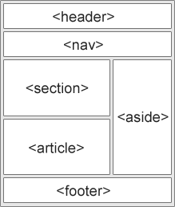
Slide 12
Sematic Tags - HTML 5
HTML5 offers new semantic elements to define different parts of a web page:
<article>
<aside>
<details>
<figcaption>
<figure>
<footer>
<header>
<main>
<mark>
<nav>
<section>
<summary>
<time>
Train
20

Slide 21
Slide 12
SVG
SVG stands for Scalable Vector Graphics
SVG is used to define graphics for the Web
SVG is a W3C recommendation
<!DOCTYPE html> <html> <body> <svg width="100" height="100"> <circle cx="50" cy="50" r="40" stroke="green" stroke-width="4" fill="yellow" /> </svg> </body> </html>
Train
21

Slide 22
Slide 12
Video and Audio
The HTML5 <video> element specifies a standard way to embed a video in a web page.
<video width="320" height="240" controls>
<source src=“Sample.mp4" type="video/mp4">
</video>
The HTML5 <audio> element specifies a standard way to embed audio in a web page.
<audio controls> <source src=“example.mp3" type="audio/mpeg"> </audio>
Train
22

Slide 23
Slide 12
Attributes
Some of the frequently used attributes
alt
disabled
href
id
src
style
title
width
height
name
Train
23

Slide 24
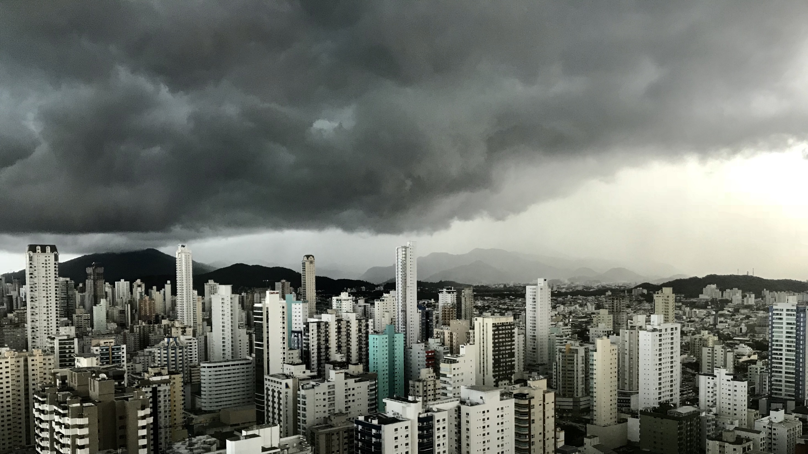
Slide 11
Assignment Time
Train

